Slide 1


Relationship between perspective taking with space and people
Sungjoon Park
sungjoon.park@tamu.edu
Spatial Thinking & STEM Learning Lab
Texas A&M University
Psychological & Brain Sciences
Notes:
Hello committee members.
Thank you for coming to my presentation of on my MAP, on the Relationship between perspective taking with space and people.

Slide 2
Overview
What is perspective taking?
Spatial and Social
Question: Is our ability to take social perspective related to our spatial perspective taking ability?
Hypotheses
Study 1
Study 2
Summary
Conclusion
Notes:
First of all, here is an overview of what I will talk about.
I will introduce you to the idea of perspective taking and how they are used for both spatial and social cognitive purposes.
This will lead into my research question and hypotheses that motivated my two studies.
Next, I will explain how those studies were conducted and discuss their results and implications to our understanding of perspective taking.

Slide 3
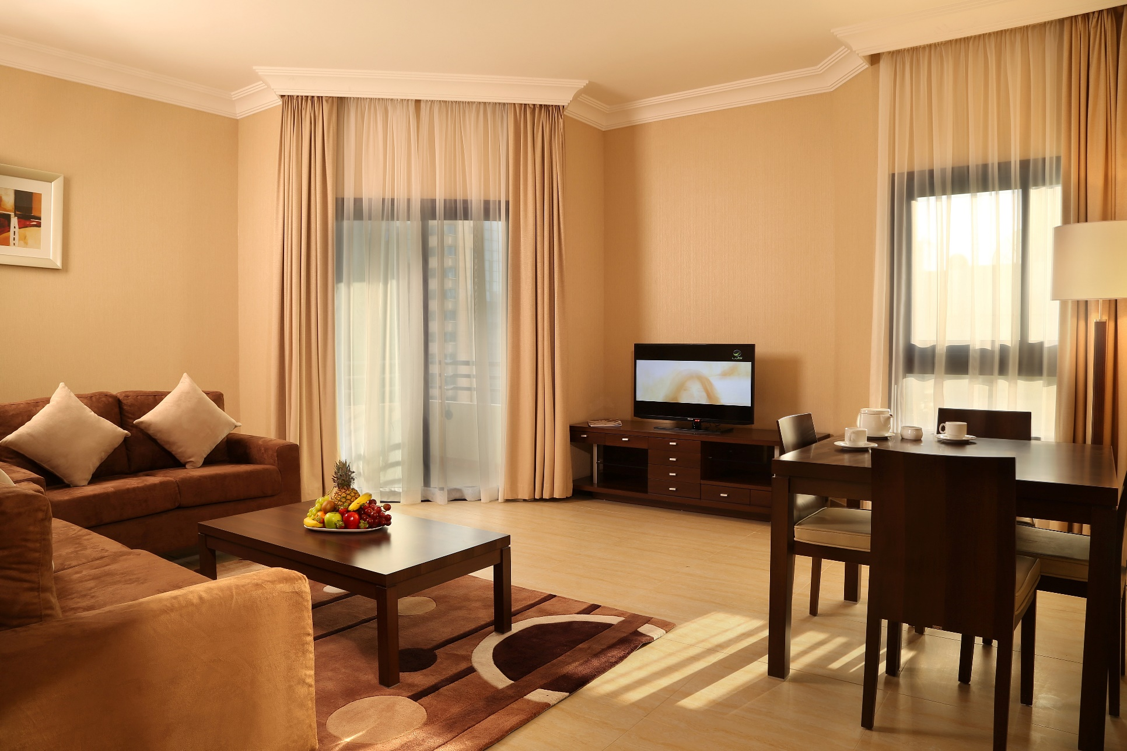
We take perspectives of things and people
Notes:
So, what is perspective taking?
Intuitively, we take perspectives all the time.
Let’s say your partner askes where the TV remote is, you can answer that it’s on YOUR right, or that it is on the dining table.
In both cases, you are intuitively thinking that your own RIGHT or LEFT might not be the same as their RIGHT or LEFT. So you take the perspective of your partner and tell them where the remote is from their PERSPECTIVE.

Slide 4
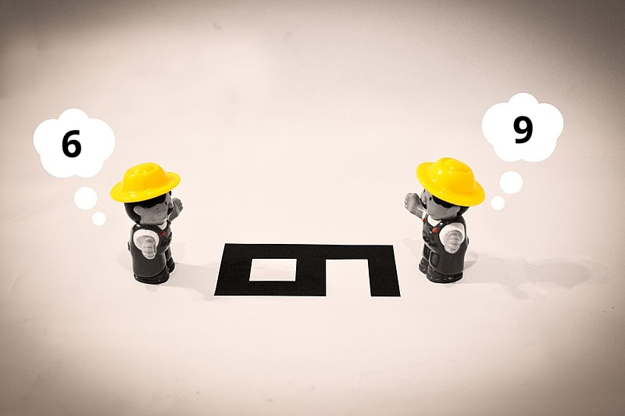
We take perspectives of things and people
https://commons.wikimedia.org/wiki/File:Point_of_view_bias.jpg
Notes:
We learned that depending on where we are, the relationship between objects and ourselves change.
In this image, these two people are looking at the same shape on the floor. For the person on the left, the shape looks like a SIX. For the person on the right, the shape looks like a NINE.
Is there a right answer to what the symbol of the image is? (Asking the audience)
That’s right, the answer depends on the reference point the symbol was intended to be interpreted.

Slide 5
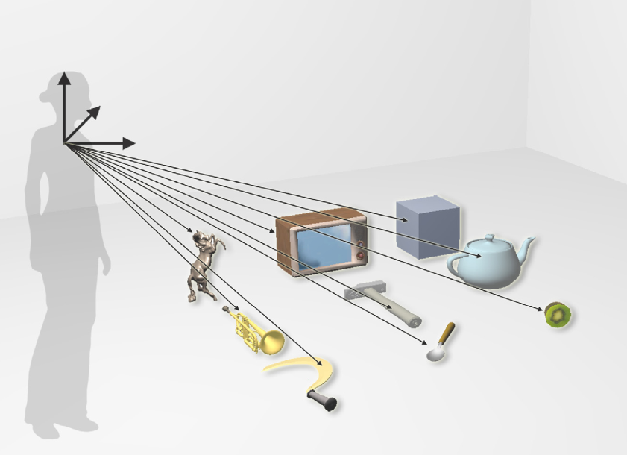
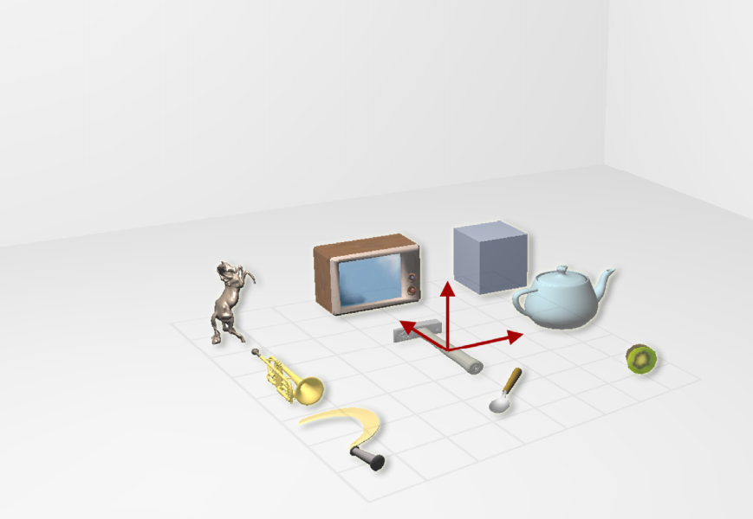
We take perspectives of things and people
Egocentric
Self
Allocentric
Other
Meilinger, T., & Vosgerau, G. (2010)
Notes:
Going back to the tv remote example.
When we only think about space in our own perspective, we are taking an egocentric perspective, and we think about where objects are in relation to ourselves; we are the reference point.
But we can also think allocentrically and think about how objects are related in reference to other things or people.
The refence can be the cardinal directions, or we can even imagine ourselves being somewhere else. I can imagine being where my partner is facing and tell them where the remote is.
Alternatively, I can simply say that the remote is on the dinning table and not worry perspective at all. This relies on our cognitive map of where objects are located and offloads the directional inference to our partner. Instead, I can let my partner infer the direction to look by using their cognitive map, or their knowledge about the layout of the room.
With our examples, it might not be surprising that perspective taking is a key part of, not only spatial cognition, but also social cognition. We often need to consider what other people know to figure out how they behave or think.

Slide 6
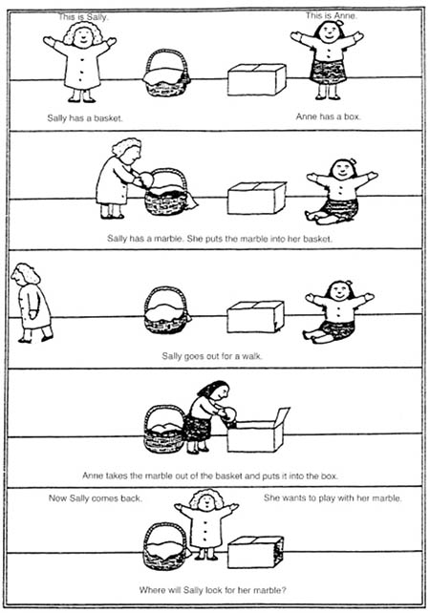
Mentalizing is social perspective taking
Self (Egocentric):
Relying on one’s own mental state when inferring other’s behavior.
Royzman et al., (2003), Apperly (2012)
Other (Allocentric):
Accounting for the difference in mental state when inferring other’s behavior.
Roßnagel, C. S. (2004), Akimoto et al., (2012)
(Baron-Cohen et al., 1985)
Notes:
As such, the idea of egocentric and allocentric perspectives are common in the mentalizing or theory of mind literature.
The ability to consider the thoughts or the state of other people is a central to mentalizing and how we socialize.
As such, we can describe mentalizing as a form of social perspective taking.
Let’s look at the classic mentalizing task where we see Sally put her ball in the basket, and then Ann takes the ball and puts it in a box.
Now answer, where would Sally look for her ball?
If we reasonably consider that Sally never saw that Ann replaced her ball, we should say that Sally would look in the basket.
If we do not consider Sally’s mental state, we might say that she would look in the box.
Or, we can change the question to, would you fault Sally for looking in the basket for her ball?
it seems like perspective taking is a very versatile ability that can is useful for not only thinking about space, but also when we interact with other people.

Slide 7
Question
Is our ability to take social perspective related to spatial perspective taking ability?
Notes:
In other words,
Does our mind process social situations and concepts like it does objects and space?

Slide 8
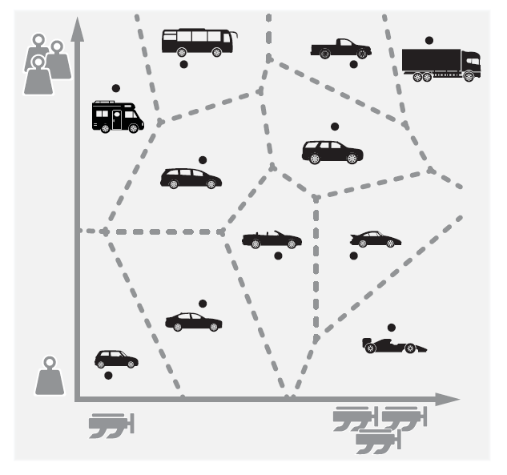
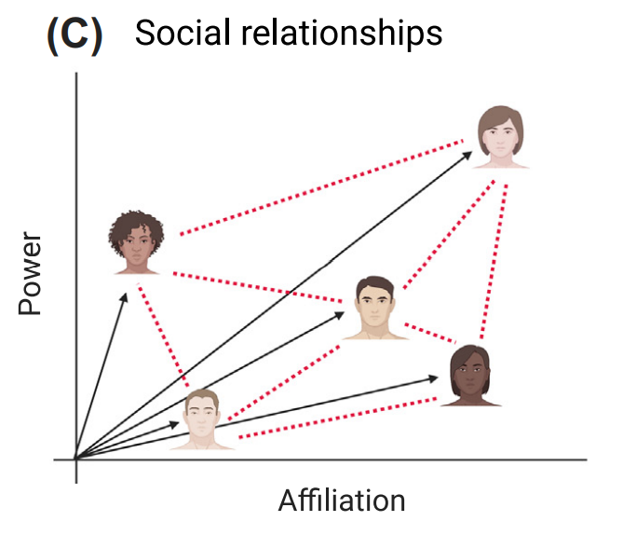
Spatial representation of social concepts
Bellmund, J. L., et al. (2018)
Banker, et al. (2021)

Slide 9
Hypotheses
People who are better at taking other’s spatial perspectives should also be better at mentalizing.
Individual differences factors involved in spatial perspective taking should also be involved in mentalizing.
Big-5 Personality, Vividness of Visualization*, Spatial Anxiety, Anxiety Symptoms
* Only in study 1
Notes:
To explore this question, we conducted a study exploring two hypotheses:
One, people who are better at taking other’s spatial perspective should also be better at mentalizing.
Two, individual difference factors involved in spatial perspective taking should also be involved in mentalizing.

Slide 10
Individual Differences
Anxiety
Negative Correlation
(Maloney et al., 2014)
-
+
Spatial Cognitive Ability
-
Spatial Anxiety
Negative Correlation
(Lyons et al., 2018)
Vividness of Visualization
Positive Correlation
(Habacha et al., 2014)
+
Big 5 Personality
Conscientiousness
Emotional Stability
(Carbone et al., 2019)
Notes:
To explore this question, we conducted a study exploring two hypotheses:
One, people who are better at taking other’s spatial perspective should also be better at mentalizing.
Two, individual difference factors involved in spatial perspective taking should also be involved in mentalizing.

Slide 11
Individual Differences
Anxiety
Negative Correlation
(Maloney et al., 2014)
-
?
Vividness of Visualization
Positive Correlation
(Maxwell et al., 2017)
+
Mentalizing Ability
Spatial Anxiety
+
Big 5 Personality
Agreeableness
(Allen et al., 2017)
Notes:
To explore this question, we conducted a study exploring two hypotheses:
One, people who are better at taking other’s spatial perspective should also be better at mentalizing.
Two, individual difference factors involved in spatial perspective taking should also be involved in mentalizing.

Slide 12
Overview
What is perspective taking?
Spatial and Social
Question: Is our ability to take social perspective related to our spatial perspective taking ability?
Hypotheses
Study 1
Method
Results
Study 2
Summary
Conclusion

Slide 13
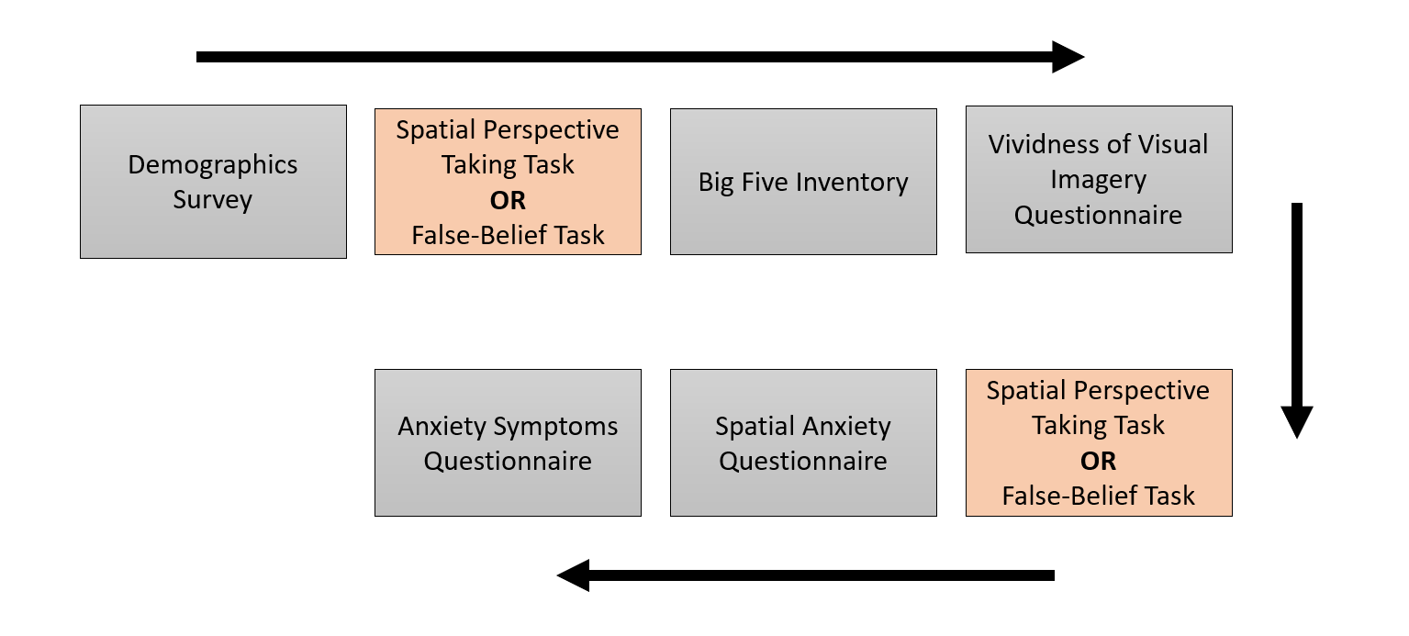
Study 1, Method
Online Study (Qualtrics)
N = 250, 147 Female, 103 Male, Mean Age = 19
Notes:
Our study was an online study on Qualtrics and we recruited 250 participants from an undergraduate student pool.
The study involved two tasks. One was a spatial perspective taking, and the other was a false belief mentalizing task.
Both of these tasks involved components where participants had to rely on their own perspective or someone else’s perspective to solve problems.
Questionnaires probing individual differences were administered in between those two tasks.

Slide 14
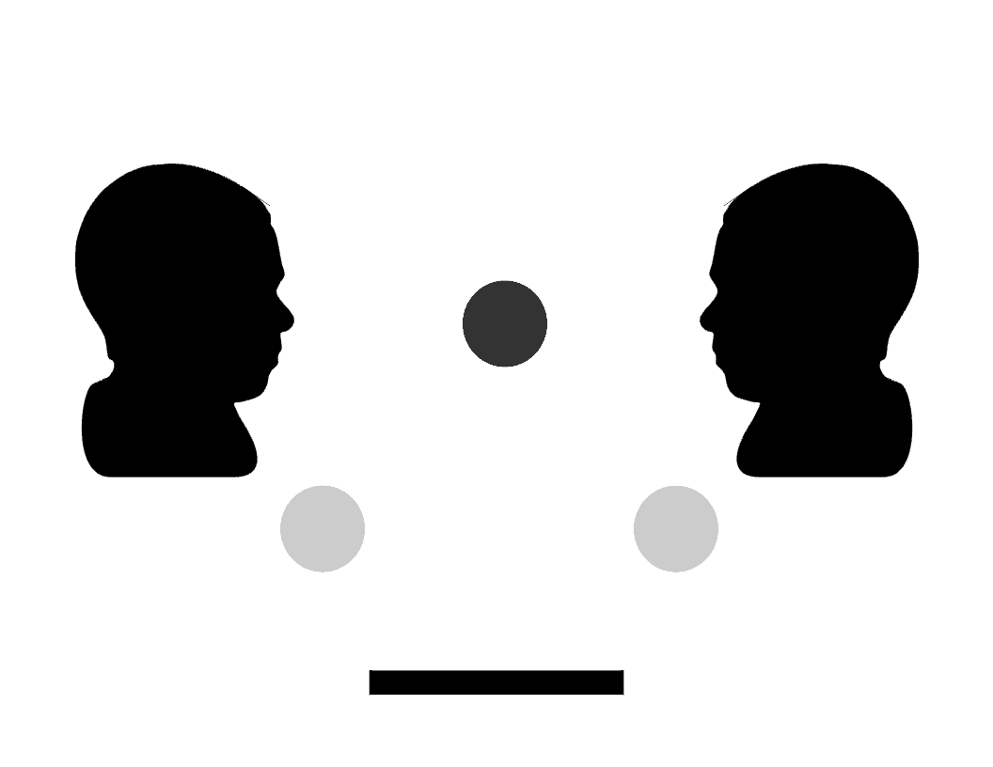
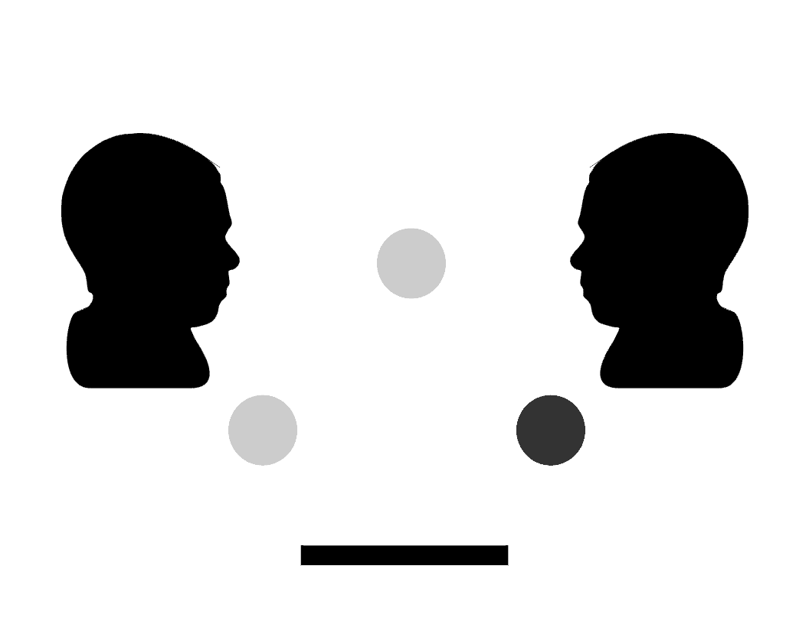
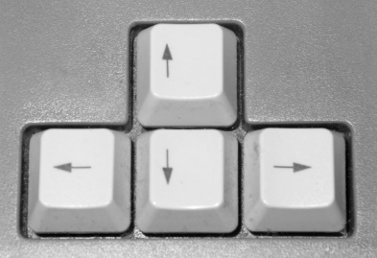

Study 1, 2D Perspective Task
Condition: “Self”
Notes:
Our study was an online study on Qualtrics and we recruited 250 participants from an undergraduate student pool.
The study involved two tasks. One was a spatial perspective taking, and the other was a false belief mentalizing task.
Both of these tasks involved components where participants had to rely on their own perspective or someone else’s perspective to solve problems.
Questionnaires probing individual differences were administered in between those two tasks.

Slide 15
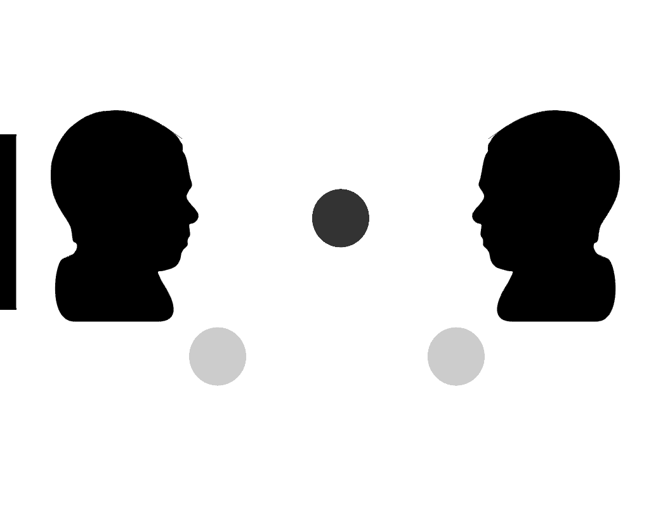
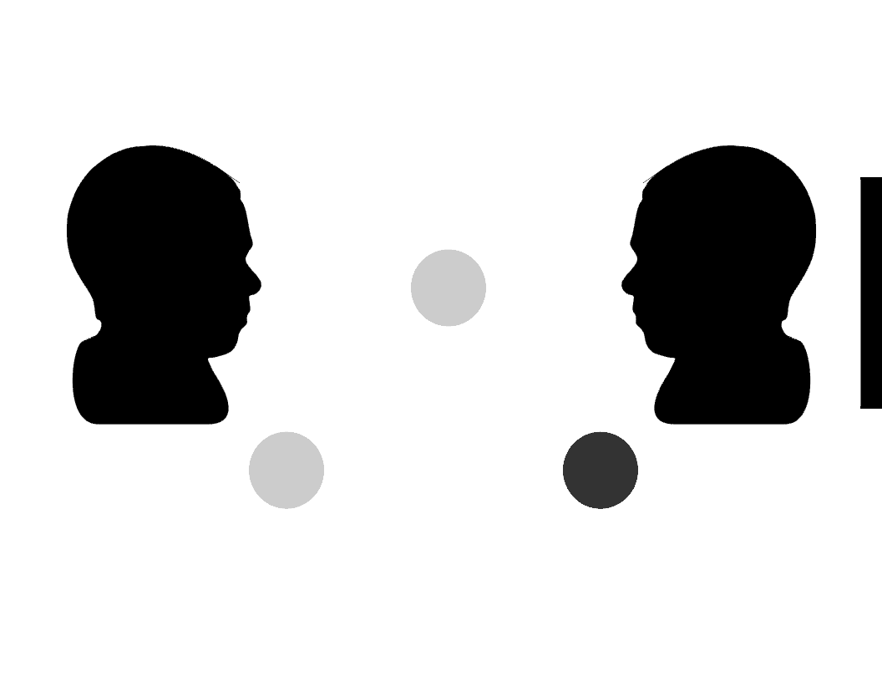


Study 1, 2D Perspective Task
Condition: “Other”
Notes:
Our study was an online study on Qualtrics and we recruited 250 participants from an undergraduate student pool.
The study involved two tasks. One was a spatial perspective taking, and the other was a false belief mentalizing task.
Both of these tasks involved components where participants had to rely on their own perspective or someone else’s perspective to solve problems.
Questionnaires probing individual differences were administered in between those two tasks.

Slide 16


Study 1, 2D Perspective Task
Condition: “Other”
Notes:
Our study was an online study on Qualtrics and we recruited 250 participants from an undergraduate student pool.
The study involved two tasks. One was a spatial perspective taking, and the other was a false belief mentalizing task.
Both of these tasks involved components where participants had to rely on their own perspective or someone else’s perspective to solve problems.
Questionnaires probing individual differences were administered in between those two tasks.

Slide 17
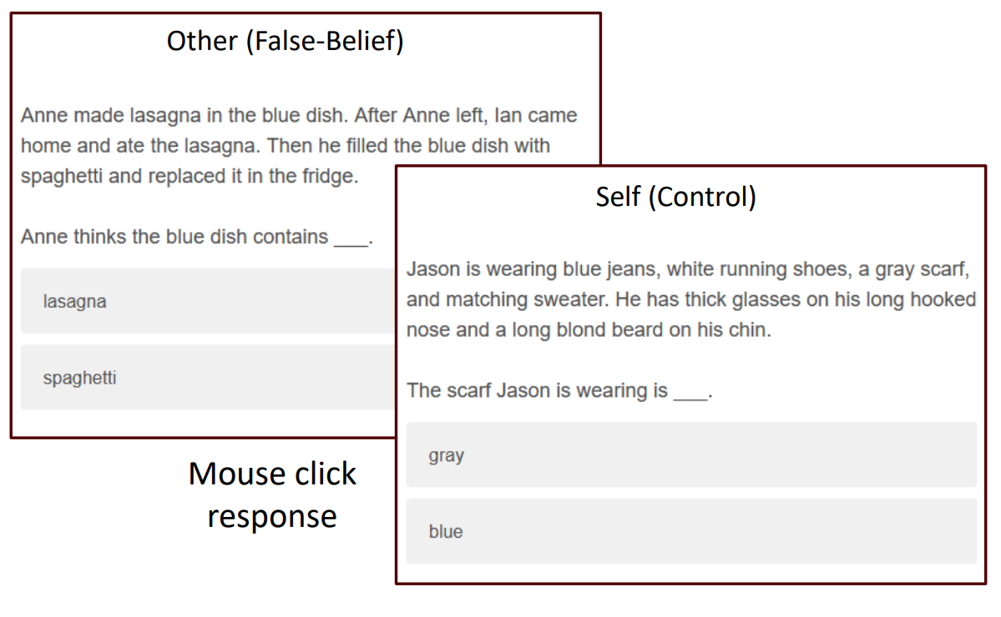

Study 1, Social Perspective Task (Mentalizing)
Correct
Incorrect
Incorrect
Correct
Adapted from Saxe & Kanwisher, 2003
Notes:
Our study was an online study on Qualtrics and we recruited 250 participants from an undergraduate student pool.
The study involved two tasks. One was a spatial perspective taking, and the other was a false belief mentalizing task.
Both of these tasks involved components where participants had to rely on their own perspective or someone else’s perspective to solve problems.
Questionnaires probing individual differences were administered in between those two tasks.

Slide 18
Study 1, Results
Notes:
Our study was an online study on Qualtrics and we recruited 250 participants from an undergraduate student pool.
The study involved two tasks. One was a spatial perspective taking, and the other was a false belief mentalizing task.
Both of these tasks involved components where participants had to rely on their own perspective or someone else’s perspective to solve problems.
Questionnaires probing individual differences were administered in between those two tasks.

Slide 19
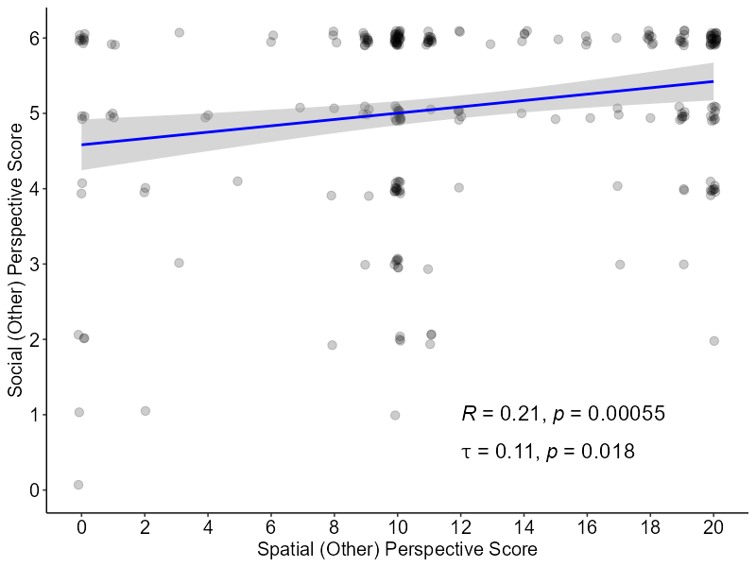
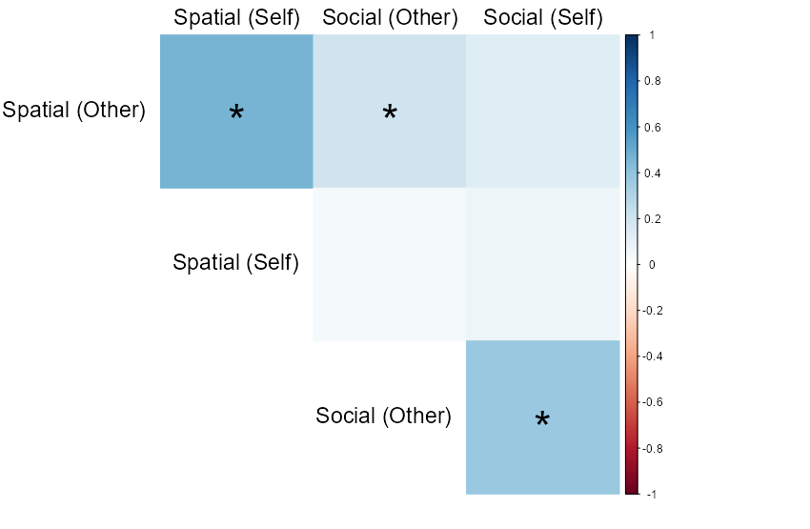
H1: People who are better at taking other’s spatial perspectives are also better at mentalizing
* Bonferroni adjusted for 4 tests α = 0.0125
Notes:
What we found was a weak correlation where people who are better at taking someone else’s spatial perspective were also better at mentalizing.

Slide 20
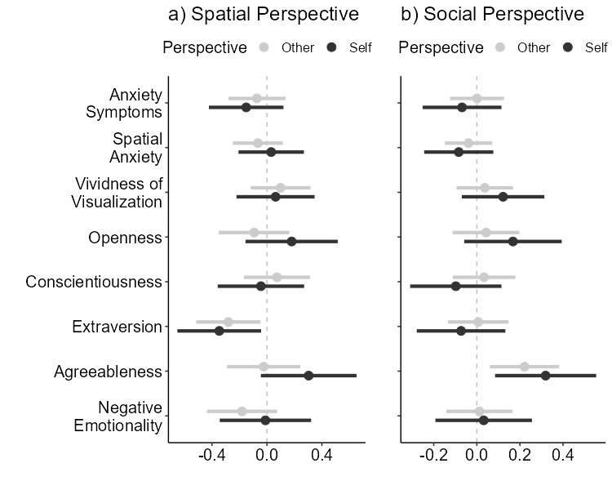
H2: No Individual Differences Factors In Common
Spatial
F(17, 482) = 6.26
p < 0.01
Adj. R² = 0.15
Social
F(17, 482) = 2.48
p < 0.01
Adj. R² = 0.05
Notes:
And our multiple regression models for individual difference factors for both spatial perspective taking and mentalizing showed no evidence that they shared any in common.
Add animation

Slide 21


I have support for H1 no support for H2
Notes:
positive correlation between taking other’s spatial perspective and mentalizing.
No individual difference factor in common.

Slide 22
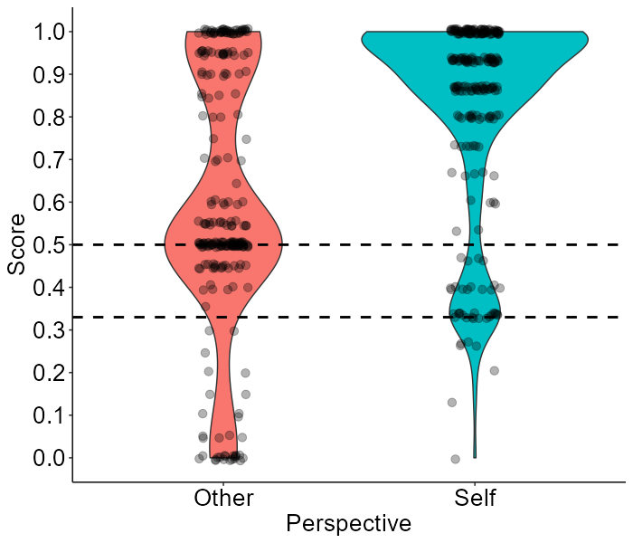
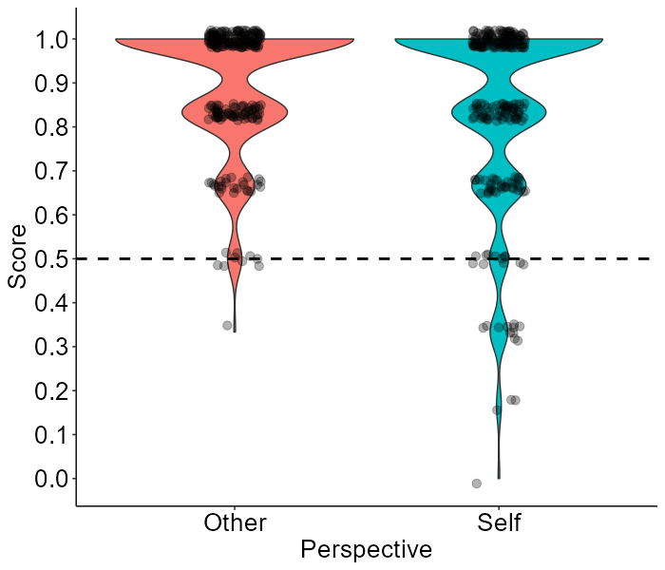
Possible ceiling effect & unfocused online participants
Spatial perspective task
Mentalizing task
Dashed lines indicate chance performance
Notes:
positive correlation between taking other’s spatial perspective and mentalizing.
No individual difference factor in common.

Slide 23
Overview
What is perspective taking?
Spatial and Social
Question: Is our ability to take social perspective related to our spatial perspective taking ability?
Hypotheses
Studies Overview
Study 1
Study 2
Changes
Method
Results
Summary
Conclusion

Slide 24
Study 2, Changes
Administered both Online and In-Person
Q1: Are online participants unreliable?
Modified perspective task to 3D
Due to concern of task ambiguity.
Added the Spatial Orientation Task (Hegarty, M., & Waller, D., 2004)
Q2: Does the perspective task have construct validity?
An established measure of perspective taking ability
Removed the Vividness of Visual Imagery Questionnaire
Theoretically unclear.
To save time due to task modifications.
Notes:
Our study was an online study on Qualtrics and we recruited 250 participants from an undergraduate student pool.
The study involved two tasks. One was a spatial perspective taking, and the other was a false belief mentalizing task.
Both of these tasks involved components where participants had to rely on their own perspective or someone else’s perspective to solve problems.
Questionnaires probing individual differences were administered in between those two tasks.

Slide 25
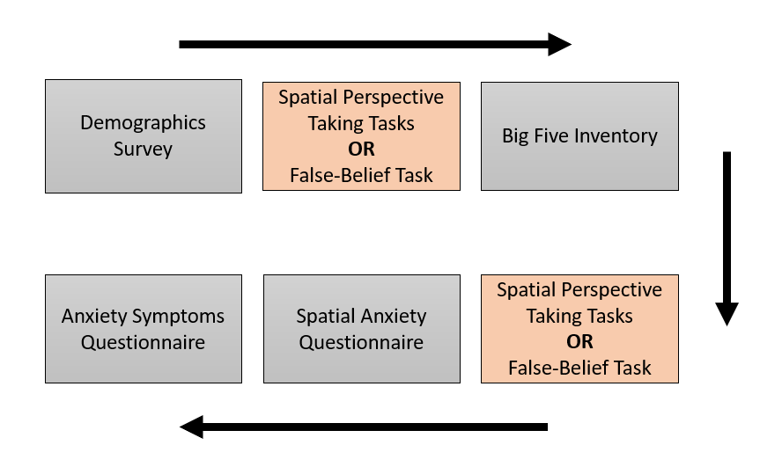
Procedure is almost identical to study 1
Online (Qualtrics)
N = 148
124 Female, 24 Male
Mean Age = 18.7
In-Person (Qualtrics)
N = 170
120 Female, 50 Male
Mean Age = 18.6
Random order of 3D perspective task and Spatial orientation task.
Notes:
Our study was an online study on Qualtrics and we recruited 250 participants from an undergraduate student pool.
The study involved two tasks. One was a spatial perspective taking, and the other was a false belief mentalizing task.
Both of these tasks involved components where participants had to rely on their own perspective or someone else’s perspective to solve problems.
Questionnaires probing individual differences were administered in between those two tasks.

Slide 26
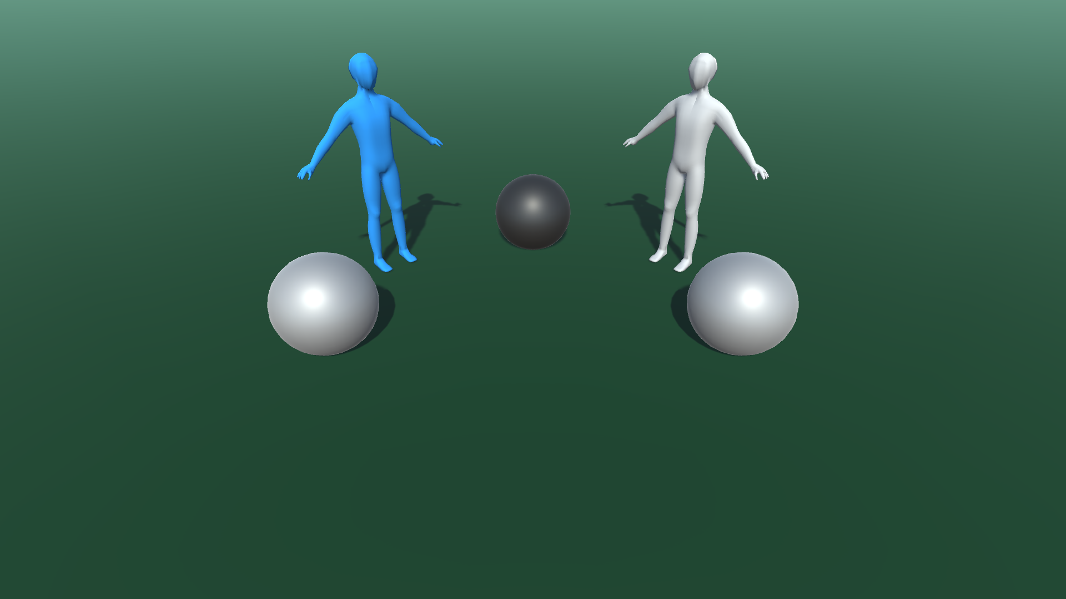
I replaced the 2D perspective task with a 3D perspective task.
Notes:
Our study was an online study on Qualtrics and we recruited 250 participants from an undergraduate student pool.
The study involved two tasks. One was a spatial perspective taking, and the other was a false belief mentalizing task.
Both of these tasks involved components where participants had to rely on their own perspective or someone else’s perspective to solve problems.
Questionnaires probing individual differences were administered in between those two tasks.

Slide 27
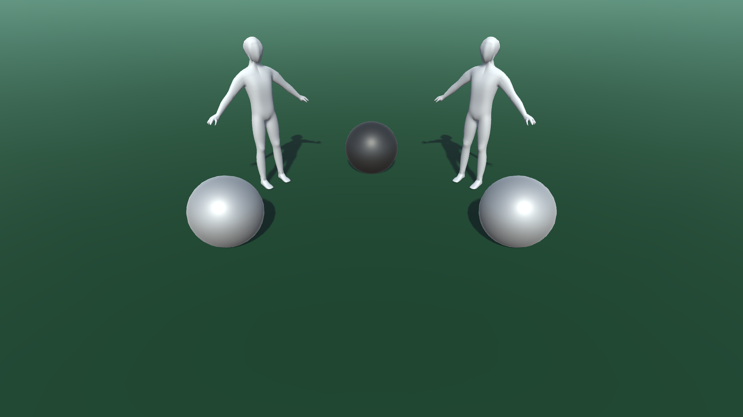
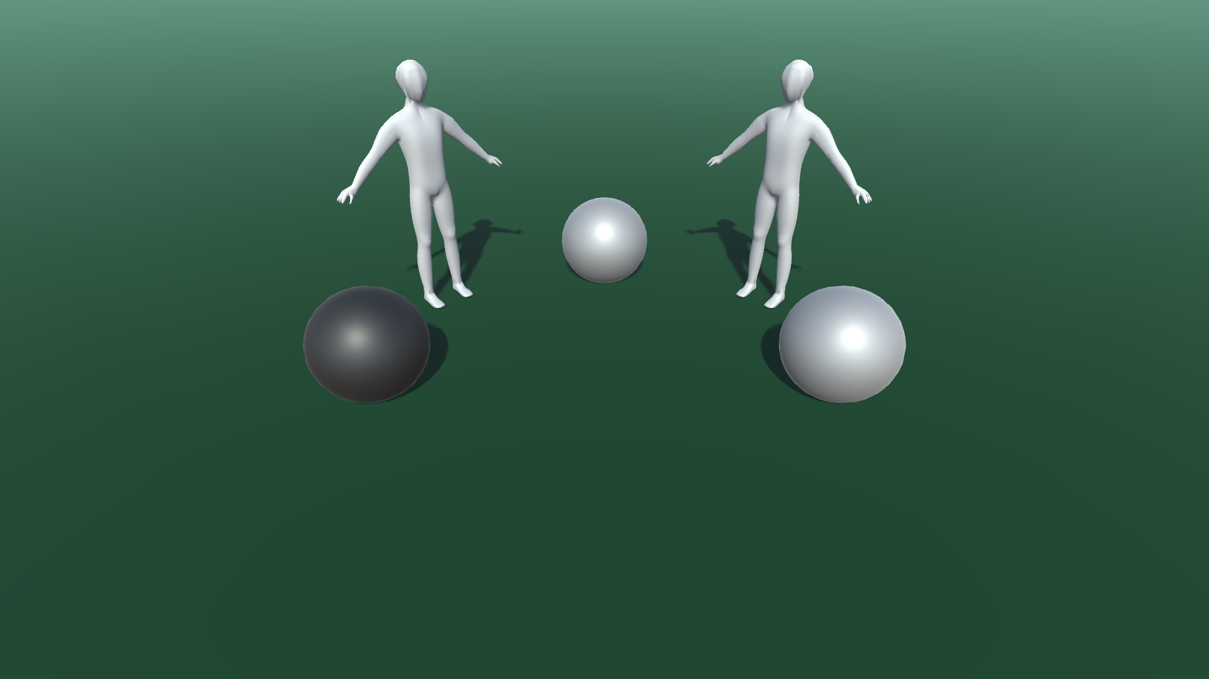
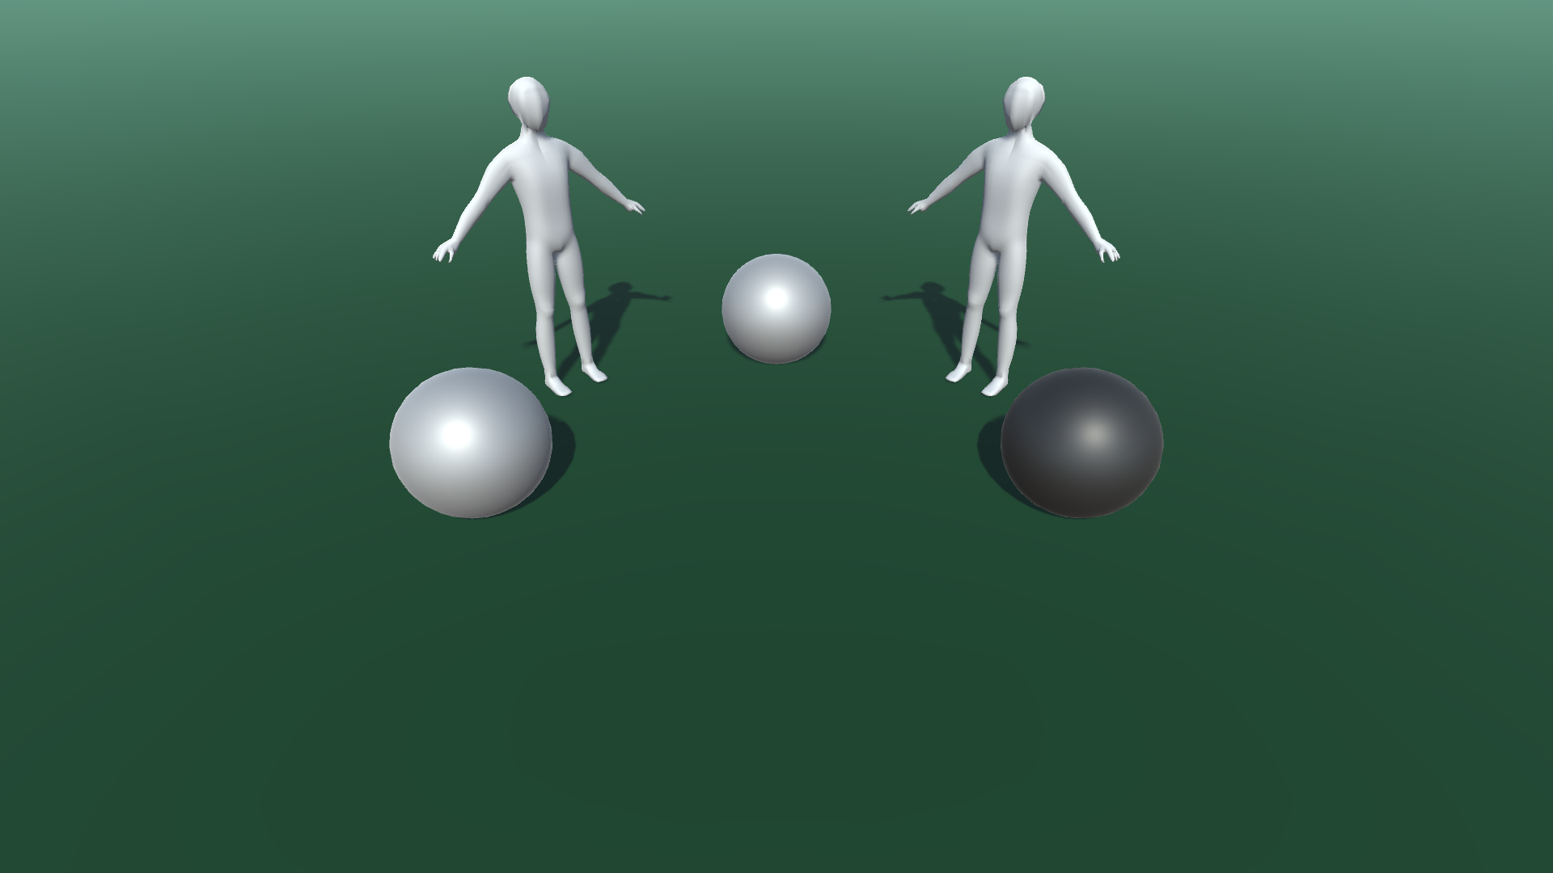

Grey mannequins indicate “self” perspective
Condition: “Self”
Notes:
Our study was an online study on Qualtrics and we recruited 250 participants from an undergraduate student pool.
The study involved two tasks. One was a spatial perspective taking, and the other was a false belief mentalizing task.
Both of these tasks involved components where participants had to rely on their own perspective or someone else’s perspective to solve problems.
Questionnaires probing individual differences were administered in between those two tasks.

Slide 28
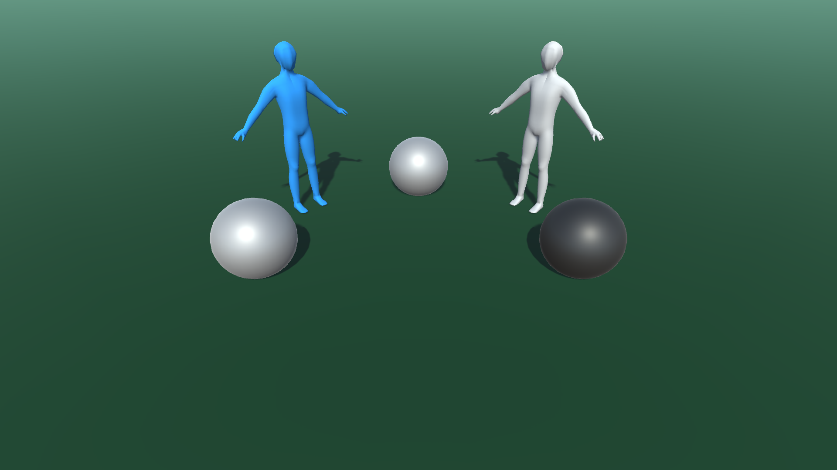
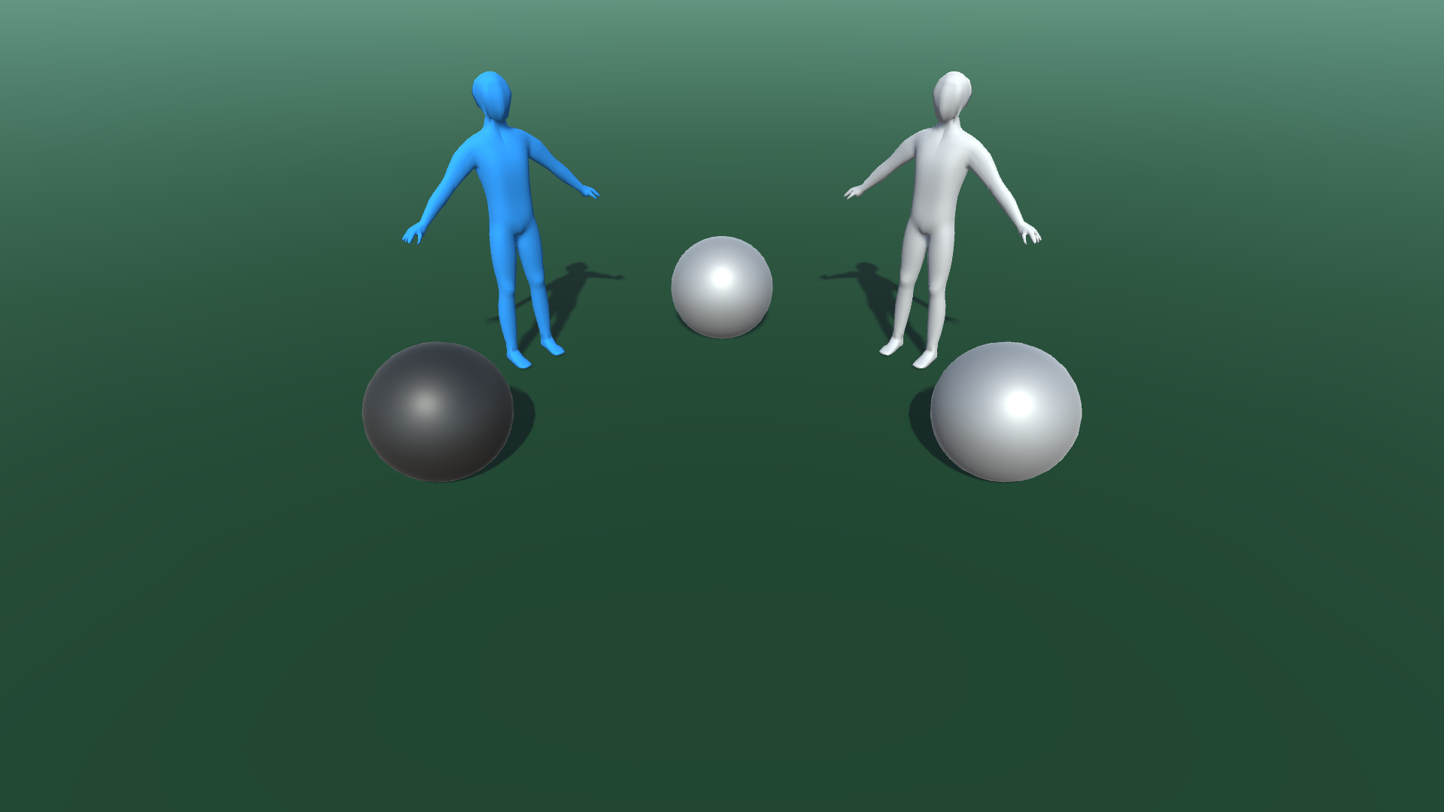
Blue mannequins indicate perspective target
Condition: “Other”
Notes:
Our study was an online study on Qualtrics and we recruited 250 participants from an undergraduate student pool.
The study involved two tasks. One was a spatial perspective taking, and the other was a false belief mentalizing task.
Both of these tasks involved components where participants had to rely on their own perspective or someone else’s perspective to solve problems.
Questionnaires probing individual differences were administered in between those two tasks.

Slide 29
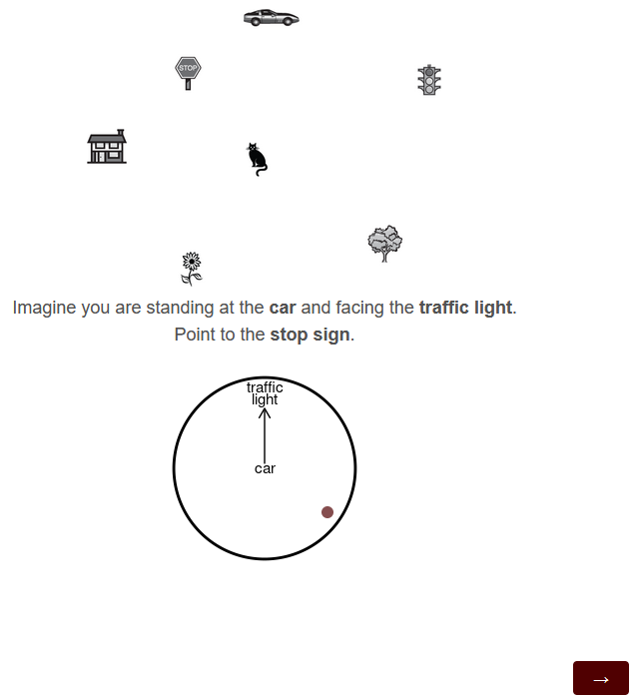
I added the Spatial Orientation Task (Hegarty, M., & Waller, D., 2004)
Notes:
Our study was an online study on Qualtrics and we recruited 250 participants from an undergraduate student pool.
The study involved two tasks. One was a spatial perspective taking, and the other was a false belief mentalizing task.
Both of these tasks involved components where participants had to rely on their own perspective or someone else’s perspective to solve problems.
Questionnaires probing individual differences were administered in between those two tasks.

Slide 30
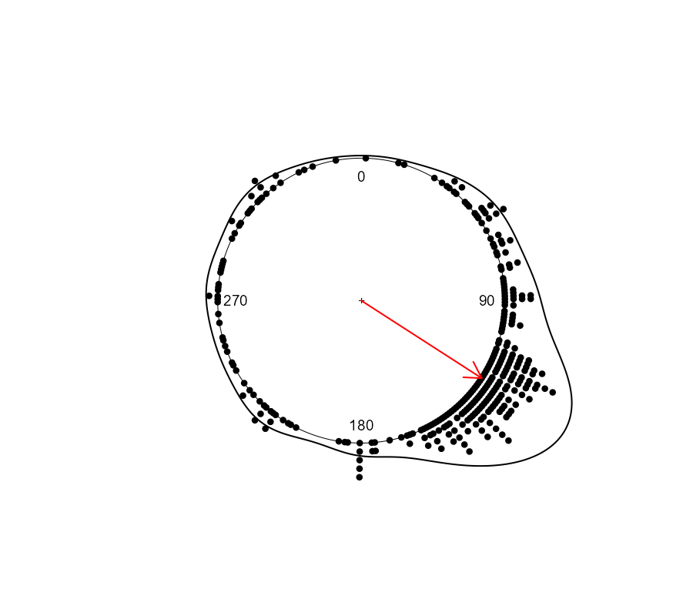
Measuring Mean Abs. Angular Deviation
Correct Answer: 123 degrees
Notes:
Our study was an online study on Qualtrics and we recruited 250 participants from an undergraduate student pool.
The study involved two tasks. One was a spatial perspective taking, and the other was a false belief mentalizing task.
Both of these tasks involved components where participants had to rely on their own perspective or someone else’s perspective to solve problems.
Questionnaires probing individual differences were administered in between those two tasks.

Slide 31
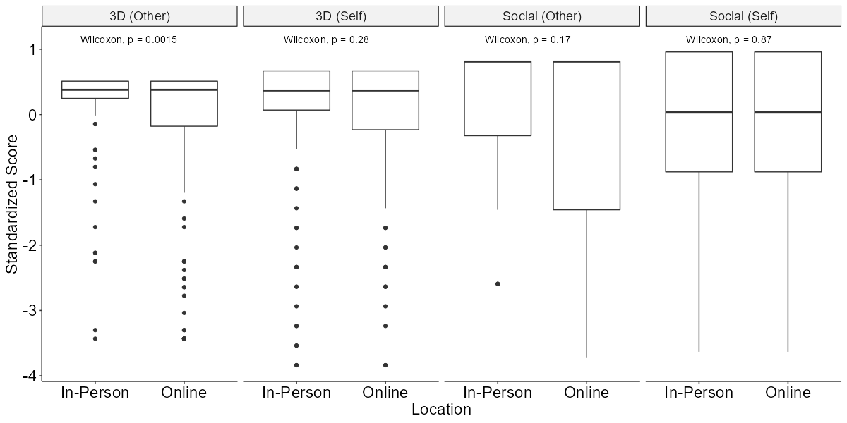
3D task performance differed by location
Notes:
Our study was an online study on Qualtrics and we recruited 250 participants from an undergraduate student pool.
The study involved two tasks. One was a spatial perspective taking, and the other was a false belief mentalizing task.
Both of these tasks involved components where participants had to rely on their own perspective or someone else’s perspective to solve problems.
Questionnaires probing individual differences were administered in between those two tasks.

Slide 32
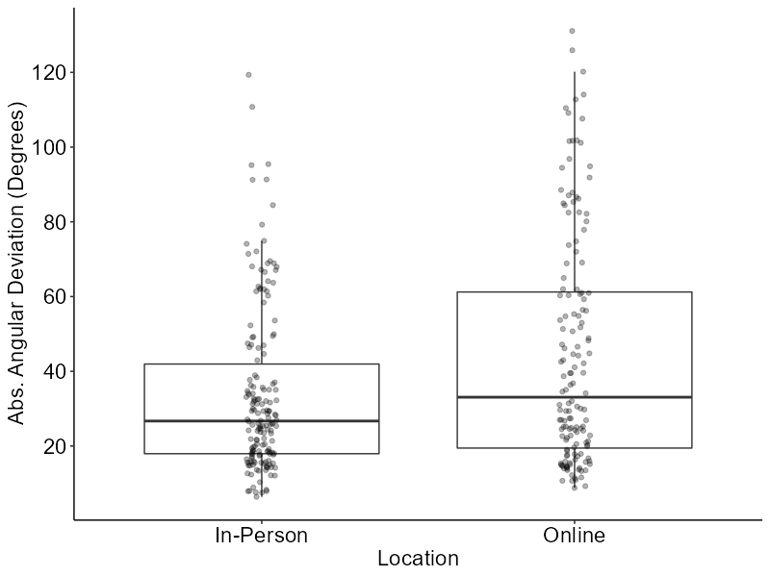
Spatial Orientation Task performance differed by location
Wilcoxon, p < 0.01
Notes:
What we found was a weak correlation where people who are better at taking someone else’s spatial perspective were also better at mentalizing.

Slide 33
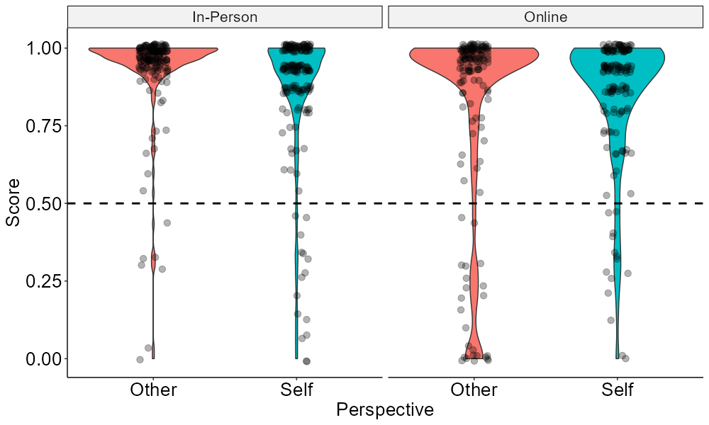
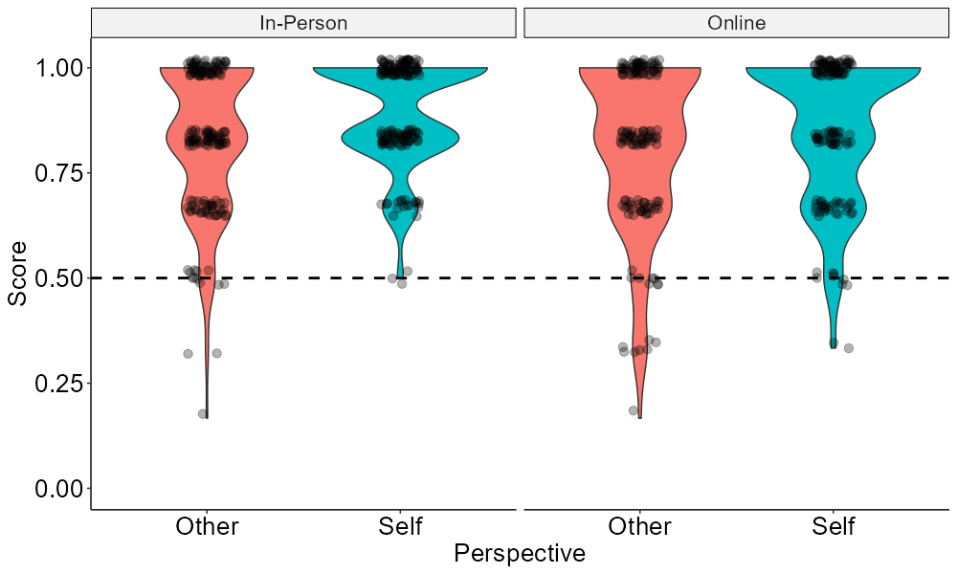
Presence of ceiling effects.
3D Perspective Task
False-Belief Task
Notes:
Our study was an online study on Qualtrics and we recruited 250 participants from an undergraduate student pool.
The study involved two tasks. One was a spatial perspective taking, and the other was a false belief mentalizing task.
Both of these tasks involved components where participants had to rely on their own perspective or someone else’s perspective to solve problems.
Questionnaires probing individual differences were administered in between those two tasks.

Slide 34
Q1: Were online participants unreliable? Unclear
3D Perspective Task
Study 1: 2D Perspective Task
Less chance performance compared to study 1
Notes:
Our study was an online study on Qualtrics and we recruited 250 participants from an undergraduate student pool.
The study involved two tasks. One was a spatial perspective taking, and the other was a false belief mentalizing task.
Both of these tasks involved components where participants had to rely on their own perspective or someone else’s perspective to solve problems.
Questionnaires probing individual differences were administered in between those two tasks.

Slide 35
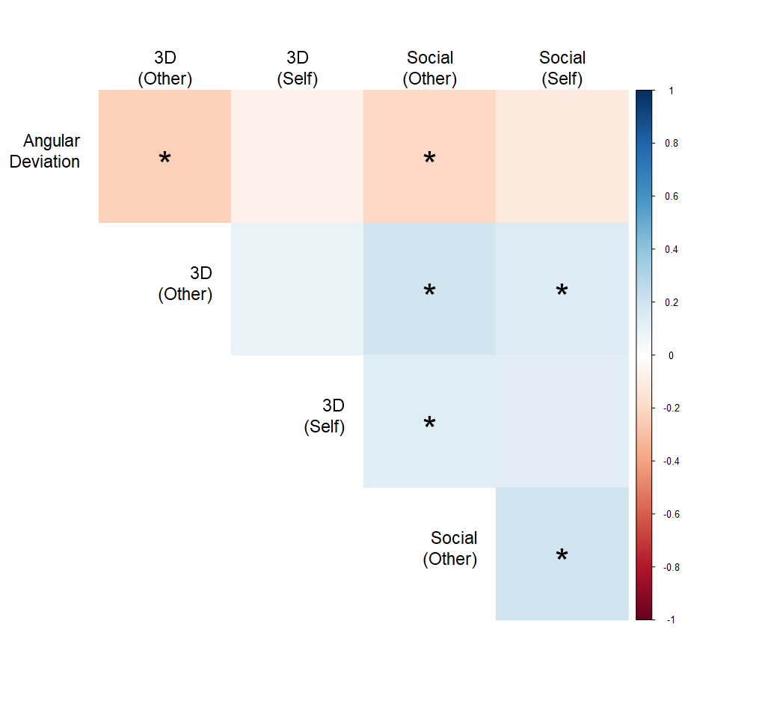
Spatial Perspective Vs Social Perspective
Study 1
Study 2
* Bonferroni adjusted for 10 tests α = 0.005
Notes:
What we found was a weak correlation where people who are better at taking someone else’s spatial perspective were also better at mentalizing.

Slide 36
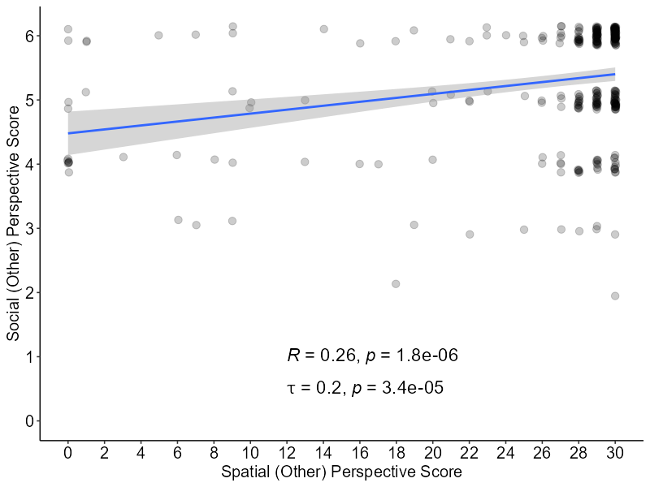
H1: People who are better at taking other’s spatial perspectives are also better at mentalizing
Study 1
Study 2
Notes:
What we found was a weak correlation where people who are better at taking someone else’s spatial perspective were also better at mentalizing.

Slide 37
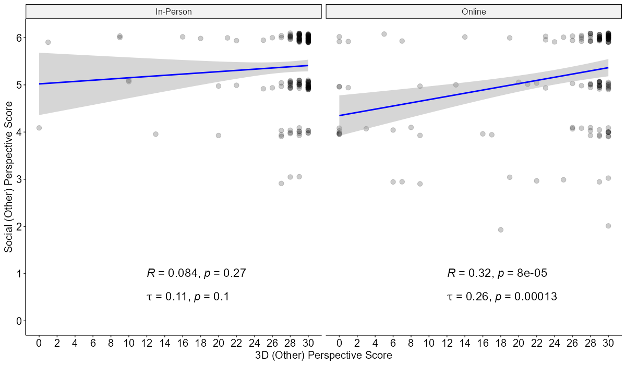
No Relationship for In-Person participants
Notes:
What we found was a weak correlation where people who are better at taking someone else’s spatial perspective were also better at mentalizing.

Slide 38
Spatial Orientation Task
* Bonferroni adjusted for 10 tests α = 0.005
Notes:
What we found was a weak correlation where people who are better at taking someone else’s spatial perspective were also better at mentalizing.

Slide 39
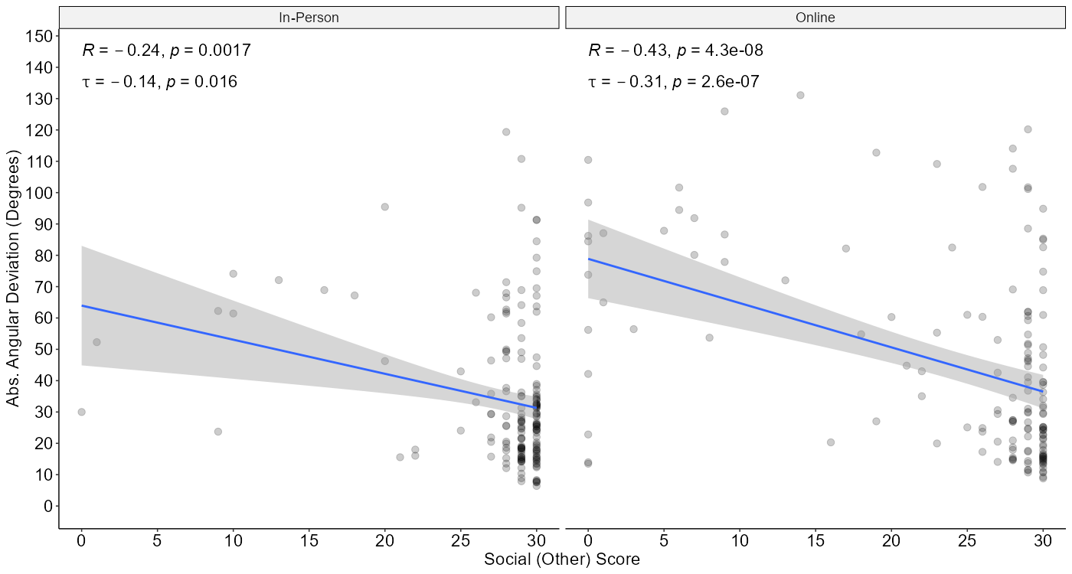
People with better spatial orientation ability are better at 3D perspective taking
3D (Other) Score
Notes:
What we found was a weak correlation where people who are better at taking someone else’s spatial perspective were also better at mentalizing.

Slide 40
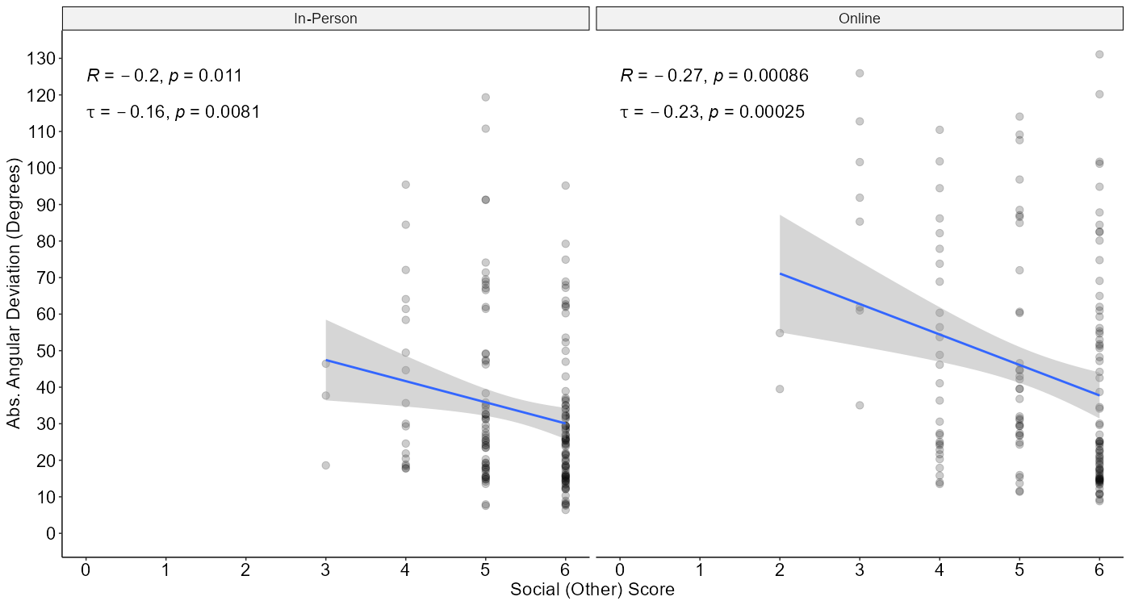
H1: People with better spatial orientation ability are better at mentalizing
Notes:
What we found was a weak correlation where people who are better at taking someone else’s spatial perspective were also better at mentalizing.

Slide 41
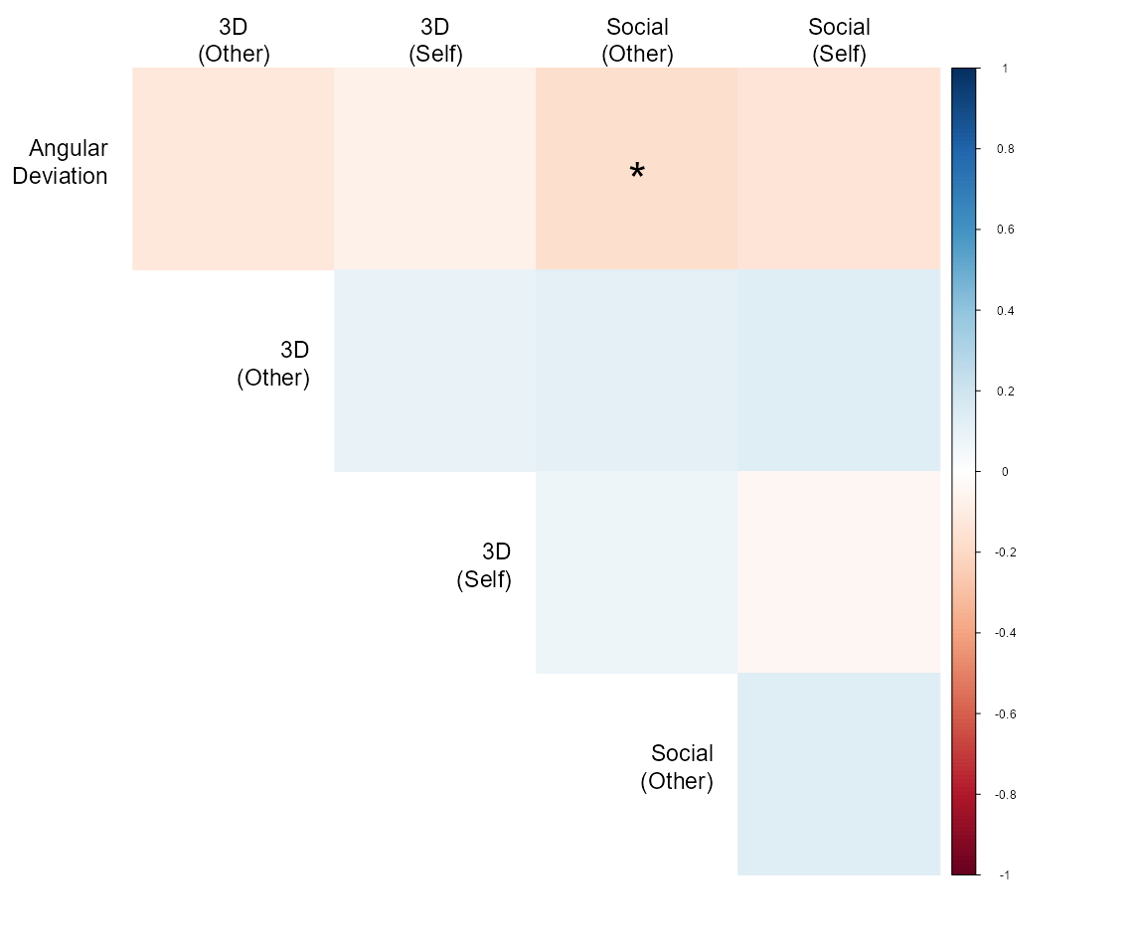
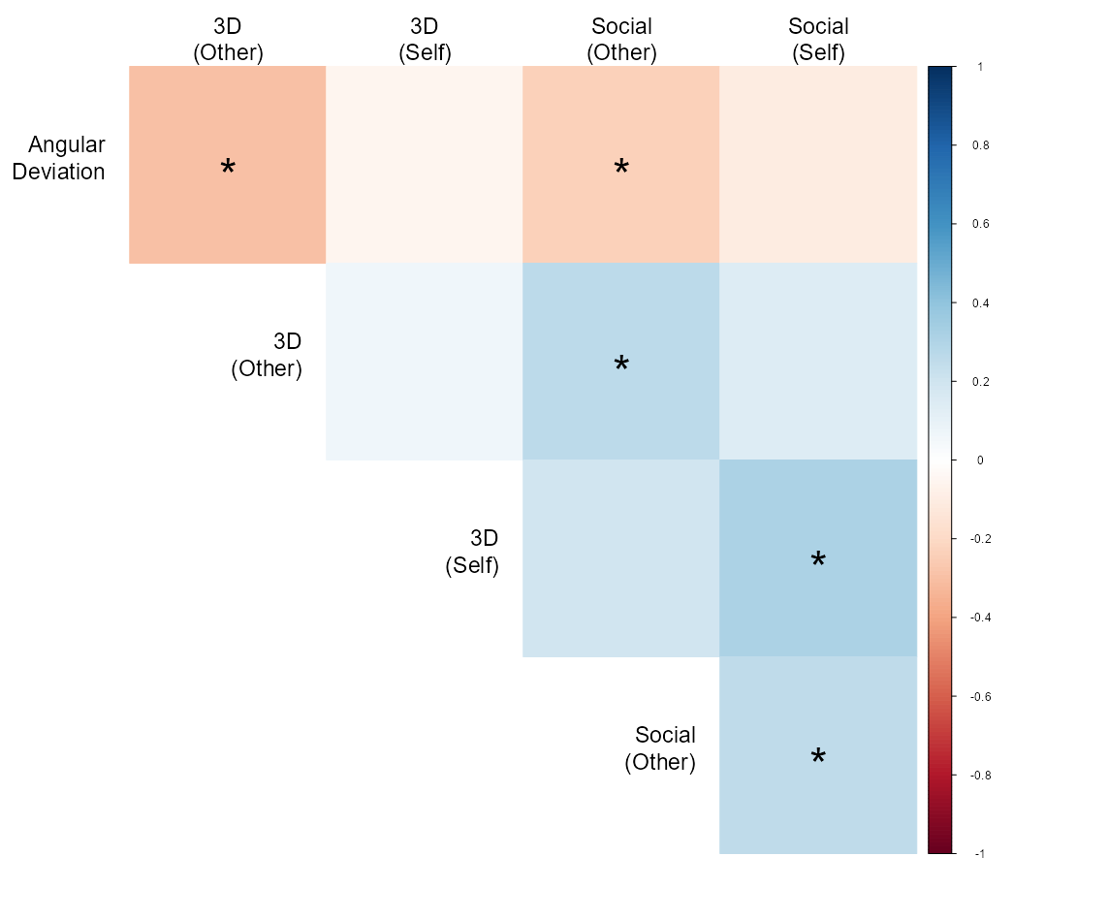
The correlations are not significant for in-person participants
In-Person
Online
Notes:
What we found was a weak correlation where people who are better at taking someone else’s spatial perspective were also better at mentalizing.

Slide 42
Q2: Does 3D perspective task have construct validity? Inconclusive H1: Is Mentalizing ability related to spatial orientation ability? YES
In-Person
Online
Notes:
What we found was a weak correlation where people who are better at taking someone else’s spatial perspective were also better at mentalizing.

Slide 43
Results: Individual Differences
Notes:
Our study was an online study on Qualtrics and we recruited 250 participants from an undergraduate student pool.
The study involved two tasks. One was a spatial perspective taking, and the other was a false belief mentalizing task.
Both of these tasks involved components where participants had to rely on their own perspective or someone else’s perspective to solve problems.
Questionnaires probing individual differences were administered in between those two tasks.

Slide 44
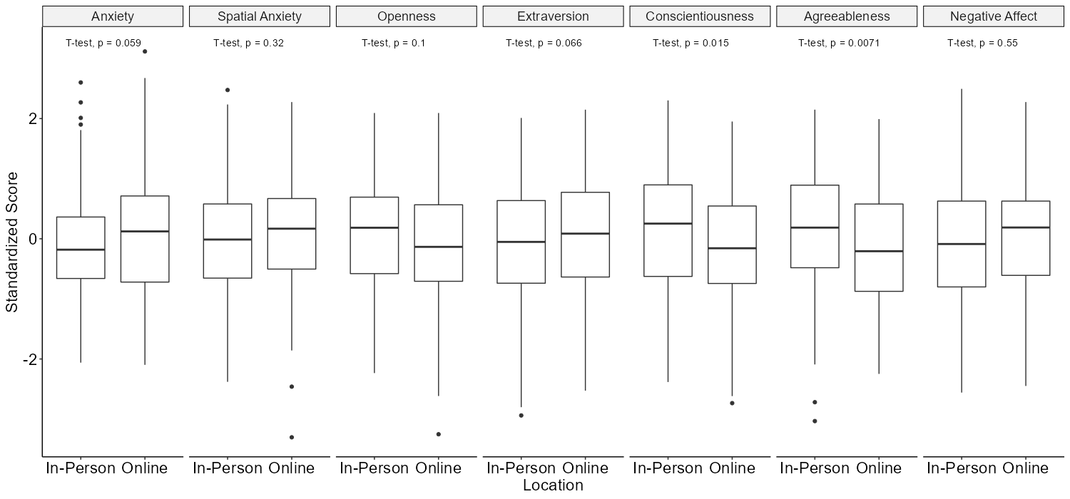
In-Person Vs Online; No difference
No significant difference with Bonferroni adjustment for 7 tests α = 0.007
Notes:
Our study was an online study on Qualtrics and we recruited 250 participants from an undergraduate student pool.
The study involved two tasks. One was a spatial perspective taking, and the other was a false belief mentalizing task.
Both of these tasks involved components where participants had to rely on their own perspective or someone else’s perspective to solve problems.
Questionnaires probing individual differences were administered in between those two tasks.

Slide 45
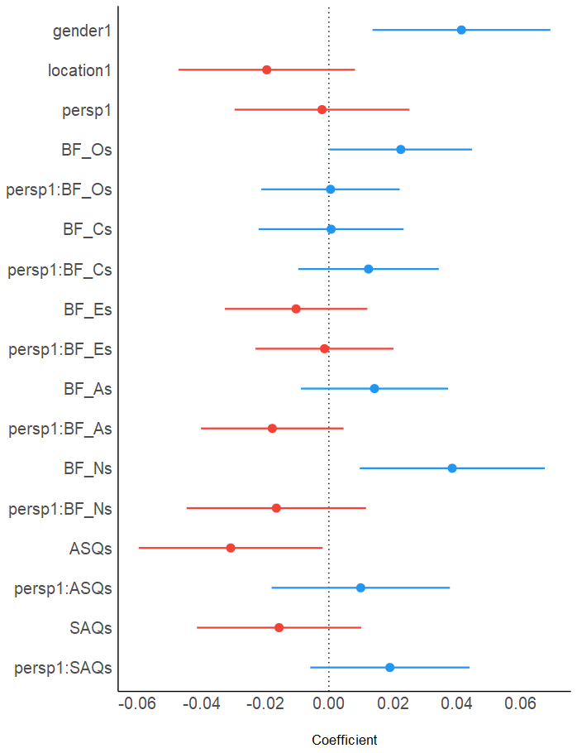
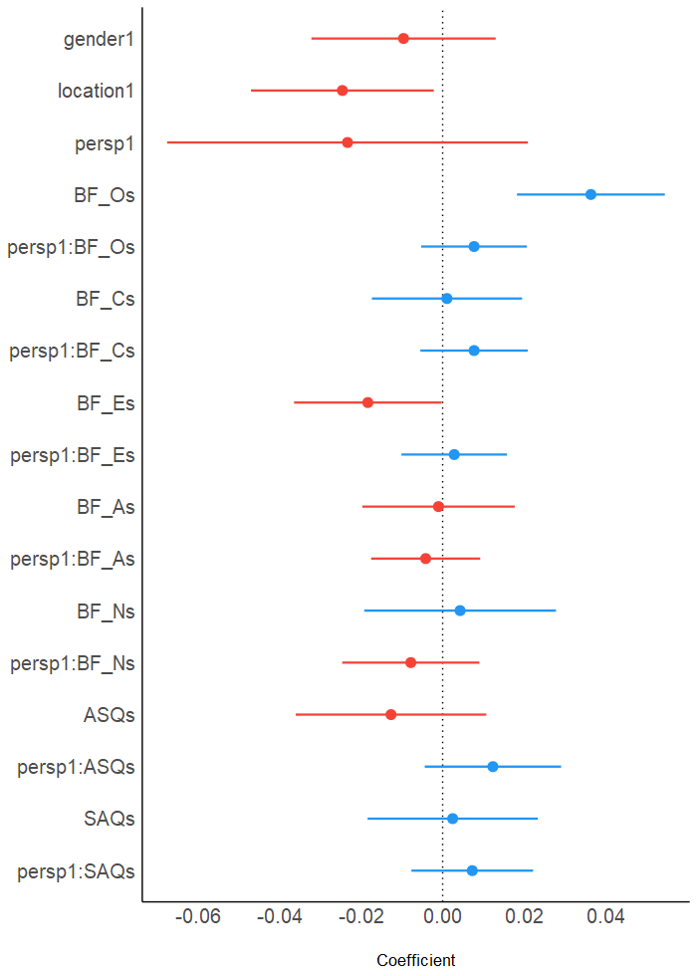
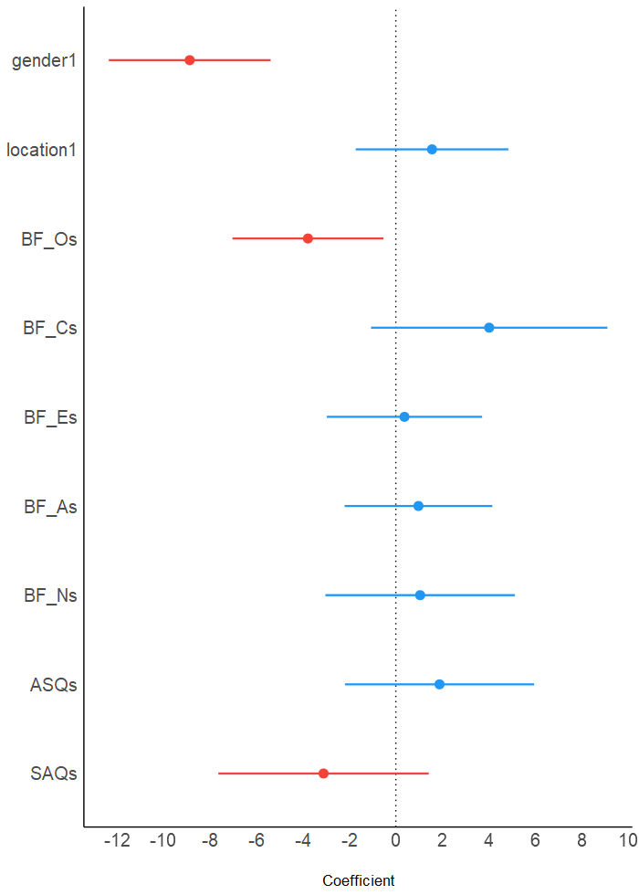
Openness was a common personality trait
3D Perspective Task
False-Belief Task
Spatial Orientation Task
Notes:
And our multiple regression models for individual difference factors for both spatial perspective taking and mentalizing showed no evidence that they shared any in common.

Slide 46
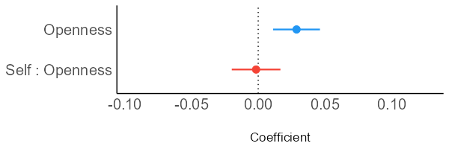
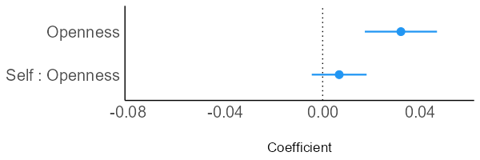
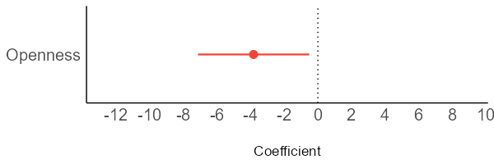
Openness was a common personality trait
3D Perspective Task
Percentage points
Mentalizing Task
Percentage points
Spatial Orientation Task
Angular degrees
Notes:
And our multiple regression models for individual difference factors for both spatial perspective taking and mentalizing showed no evidence that they shared any in common.

Slide 47
Overview
What is perspective taking?
Spatial and Social
Question: Is our ability to take social perspective related to our spatial perspective taking ability?
Hypotheses
Studies Overview
Study 1
Study 2
Summary
Limitation
Conclusion

Slide 48
Summary
Q: Is our ability to take social perspective related to spatial perspective taking ability?
Hypotheses:
H1: People who are better at taking other’s spatial perspectives should also be better at mentalizing.
H2: Individual differences factors involved in spatial perspective taking should also be involved in mentalizing.
Notes:
How would you study social concepts in a spatial manner.

Slide 49
H1: Some evidence that people who are better at taking other’s spatial perspectives are also be better at mentalizing.
In-Person
Online
Notes:
Cognitive load and availability of cognitive resources has been related to poorer ability to be empathetic.

Slide 50
H2: Openness is a personality trait that is commonly predicts spatial and social perspective taking ability.
3D Perspective Task
Percentage points
False-Belief Task
Percentage points
Spatial Orientation Task
Angular degrees
Notes:
What we found was a weak correlation where people who are better at taking someone else’s spatial perspective were also better at mentalizing.

Slide 51
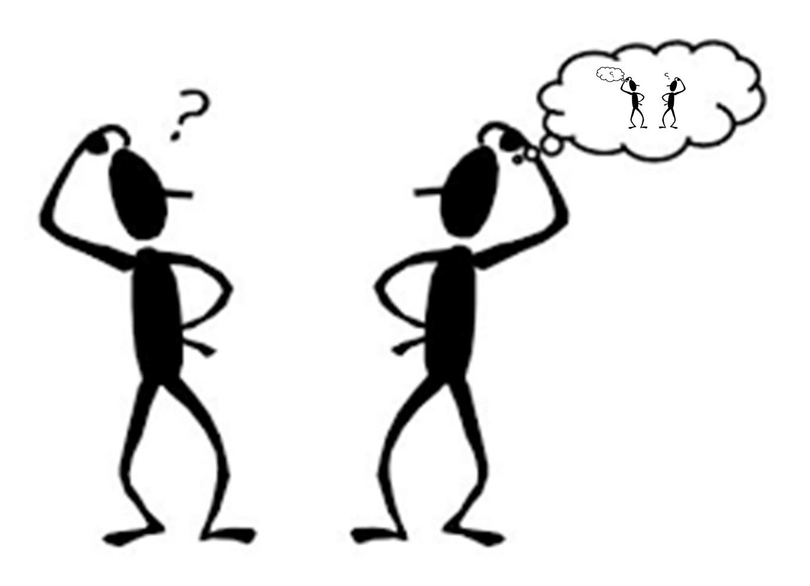
Conclusion
Mentalizing may be a form of spatial perspective taking.
Social concepts can be understood through spatial reasoning.
Notes:
How would you study social concepts in a spatial manner.

Slide 52
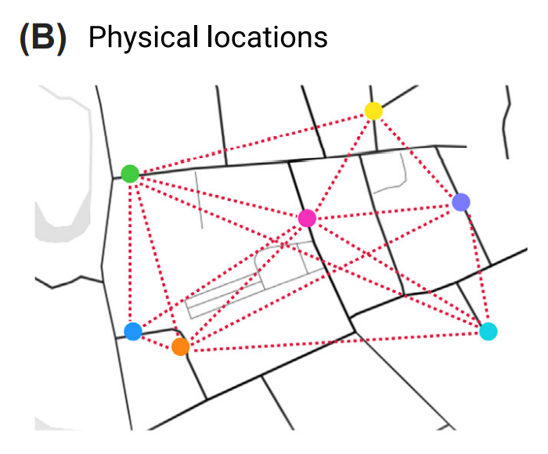
Better understanding of how both spatial and social concepts are represented.
Y
X
(Banker et. al., 2021)

Slide 53
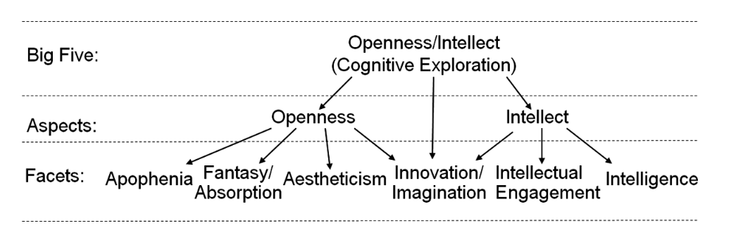
Relationship with Openness
DeYoung, C. G. (2015)

Slide 54
Combination of Spatial Ability and Experience
Bellmund, J. L., et al. (2018)
Banker, et al. (2021)

Slide 55
References
Akimoto, Y., Miyazawa, S., & Muramoto, T. (2012). Comprehension processes of verbal irony: The effects of salience, egocentric context, and allocentric theory of mind. Metaphor and Symbol, 27(3), 217–242. https://doi.org/10.1080/10926488.2012.691750
Allen, T. A., Rueter, A. R., Abram, S. V., Brown, J. S., & Deyoung, C. G. (2017). Personality and neural correlates of mentalizing ability. European Journal of Personality, 31(6), 599–613. https://doi.org/10.1002/per.2133
Apperly, I. A. (2012). What is “theory of mind”? Concepts, cognitive processes and individual differences. Quarterly Journal of Experimental Psychology, 65(5), 825–839. https://doi.org/10.1080/17470218.2012.676055
Banker, S. M., Gu, X., Schiller, D., & Foss-Feig, J. H. (2021). Hippocampal contributions to social and cognitive deficits in autism spectrum disorder. Trends in Neurosciences, 44(10), 793–807. https://doi.org/10.1016/j.tins.2021.08.005
Baron-Cohen, S., Leslie, A. M., & Frith, U. (1985). Does the autistic child have a “theory of mind” ? Cognition, 21(1), 37–46. https://doi.org/10.1016/0010-0277(85)90022-8
Bellmund, J. L. S., Gärdenfors, P., Moser, E. I., & Doeller, C. F. (2018). Navigating cognition: Spatial codes for human thinking. Science, 362(6415), eaat6766. https://doi.org/10.1126/science.aat6766
Carbone, E., Meneghetti, C., & Borella, E. (2019). The influence of personality traits and facets on visuo-spatial task performance and self-assessed visuo-spatial inclinations in young and older adults. PLOS ONE, 14(8), e0220525. https://doi.org/10.1371/journal.pone.0220525
DeYoung, C. G. (2015). Openness/intellect: A dimension of personality reflecting cognitive exploration. In M. Mikulincer, P. R. Shaver, M. L. Cooper, & R. J. Larsen (Eds.), APA handbook of personality and social psychology, Volume 4: Personality processes and individual differences. (pp. 369–399). American Psychological Association. https://doi.org/10.1037/14343-017
Habacha, H., Molinaro, C., & Dosseville, F. (2014). Effects of gender, imagery ability, and sports practice on the performance of a mental rotation task. The American Journal of Psychology, 127(3), 313–323. https://doi.org/10.5406/amerjpsyc.127.3.0313
Hegarty, M. (2004). A dissociation between mental rotation and perspective-taking spatial abilities. Intelligence, 32(2), 175–191. https://doi.org/10.1016/j.intell.2003.12.001
Lyons, I. M., Ramirez, G., Maloney, E. A., Rendina, D. N., Levine, S. C., & Beilock, S. L. (2018). Spatial anxiety: A novel questionnaire with subscales for measuring three aspects of spatial anxiety. Journal of Numerical Cognition, 4(3), 526–553. https://doi.org/10.5964/jnc.v4i3.154
Maloney, E. A., Sattizahn, J. R., & Beilock, S. L. (2014). Anxiety and cognition. WIREs Cognitive Science, 5(4), 403–411. https://doi.org/10.1002/wcs.1299
Maxwell, R., Lynn, S. J., & Lilienfeld, S. (2017). Failures to imagine: Mental imagery in psychopathy and emotional regulation difficulties. Imagination, Cognition and Personality, 36(3), 270–300. https://doi.org/10.1177/0276236616679963
Meilinger, T., & Vosgerau, G. (2010). Putting egocentric and allocentric into perspective. In C. Hölscher, T. F. Shipley, M. Olivetti Belardinelli, J. A. Bateman, & N. S. Newcombe (Eds.), Spatial Cognition VII (Vol. 6222, pp. 207–221). Springer Berlin Heidelberg. https://doi.org/10.1007/978-3-642-14749-4_19
Roßnagel, C. S. (2004). Lost in thought: Cognitive load and the processing of addressees’ feedback in verbal communication. Experimental Psychology, 51(3), 191–200. https://doi.org/10.1027/1618-3169.51.3.191
Royzman, E. B., Cassidy, K. W., & Baron, J. (2003). “I know, you know”: Epistemic egocentrism in children and adults. Review of General Psychology, 7(1), 38–65. https://doi.org/10.1037/1089-2680.7.1.38
Saxe, R., Carey, S., & Kanwisher, N. (2004). Understanding other minds: Linking developmental psychology and functional neuroimaging. Annual Review of Psychology, 55(1), 87–124. https://doi.org/10.1146/annurev.psych.55.090902.142044
Notes:
In conclusion, we have very limited evidence to support the idea that reference frames are a shared or general mechanism for both spatial and social thinking.
This suggests that people who tend to be good at taking perspectives to solve spatial problems like navigation or map reading, may not necessarily be good at mentalizing or being empathetic.
This suggests that people’s ability to take perspectives to solve spatial problems like navigation or map reading, have little in relation to how well people can empathize and be cognizant about other people’s thoughts.

